Slide 1
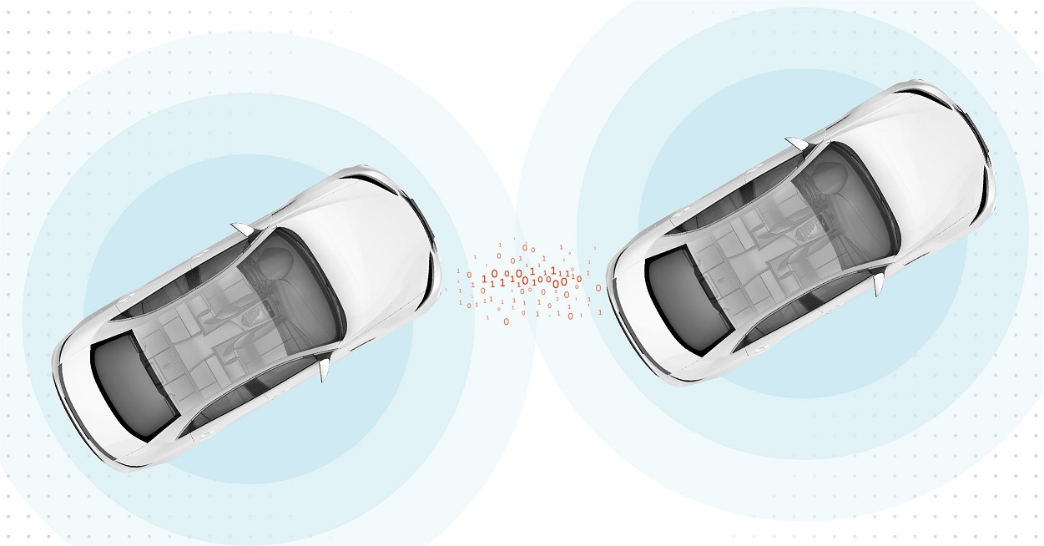
V2V
El-Sayed Shalaby

Slide 2
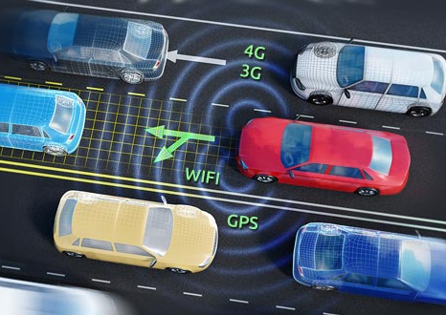
Agenda
Introduction
Application
Layered architecture
WIFI ultrasonic
h bridge
lcd
future features

Slide 3
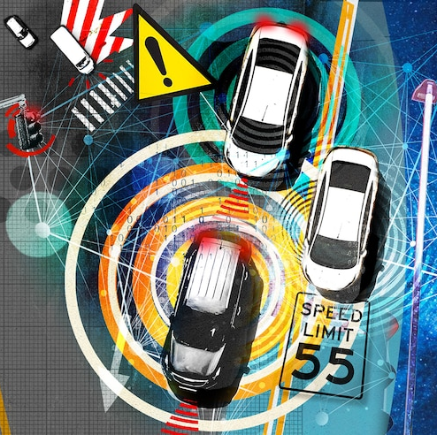
Introduction

Slide 4
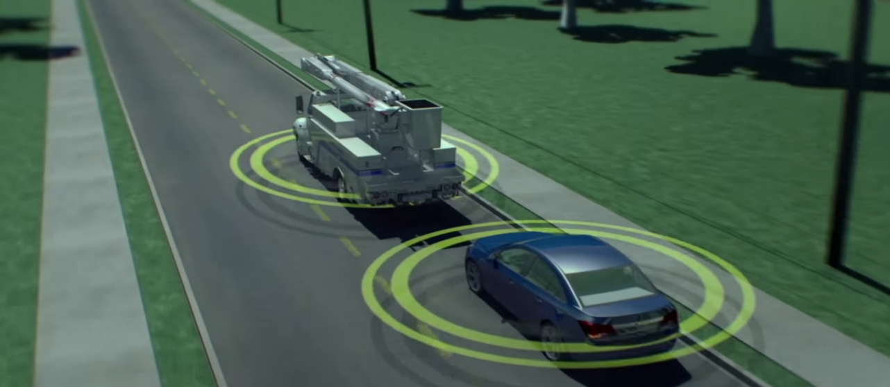
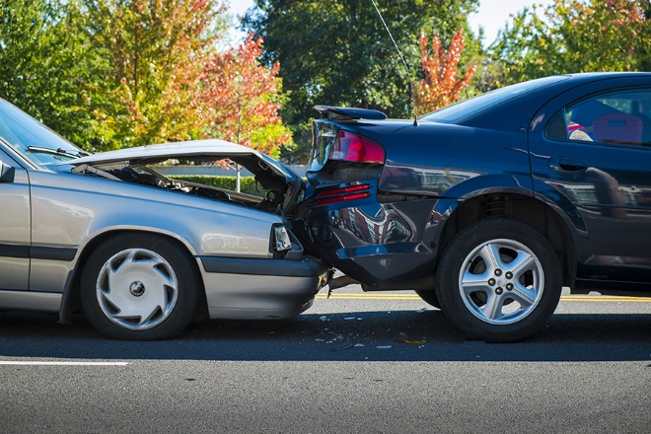
Introduction
V2V It’s a way That Vehicles can Communicate with each others depending on Communication Protocol like WI-FI Module Where the Vehicle shared It’s data like (Location , distance , speed and direction ) to another vehicle to avoid the Crush.
Why V2V
V2V application was able to avoid car crashes by 600,000 accident per year.

Slide 5
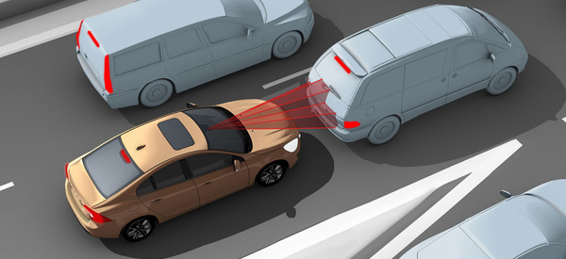
Application
The project is There are two Cars the first one interface with 2 ultrasonic sensors with LCD and WI-FI Module and the other car receives an distance information from the first one to take an action.
Optical Avoidance

Slide 6
Application

Slide 7
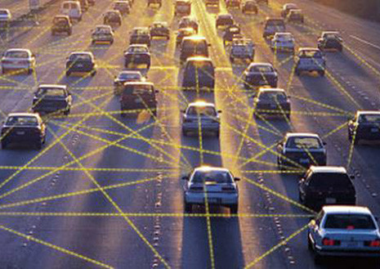
APPLICATION
component flowchart sequence diagram

Slide 8
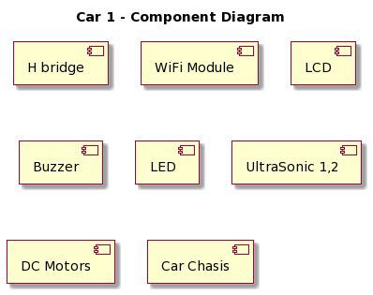
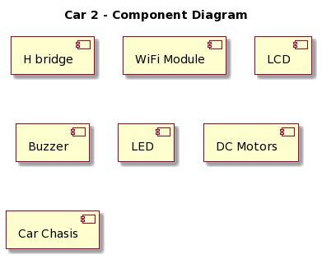
components

Slide 9
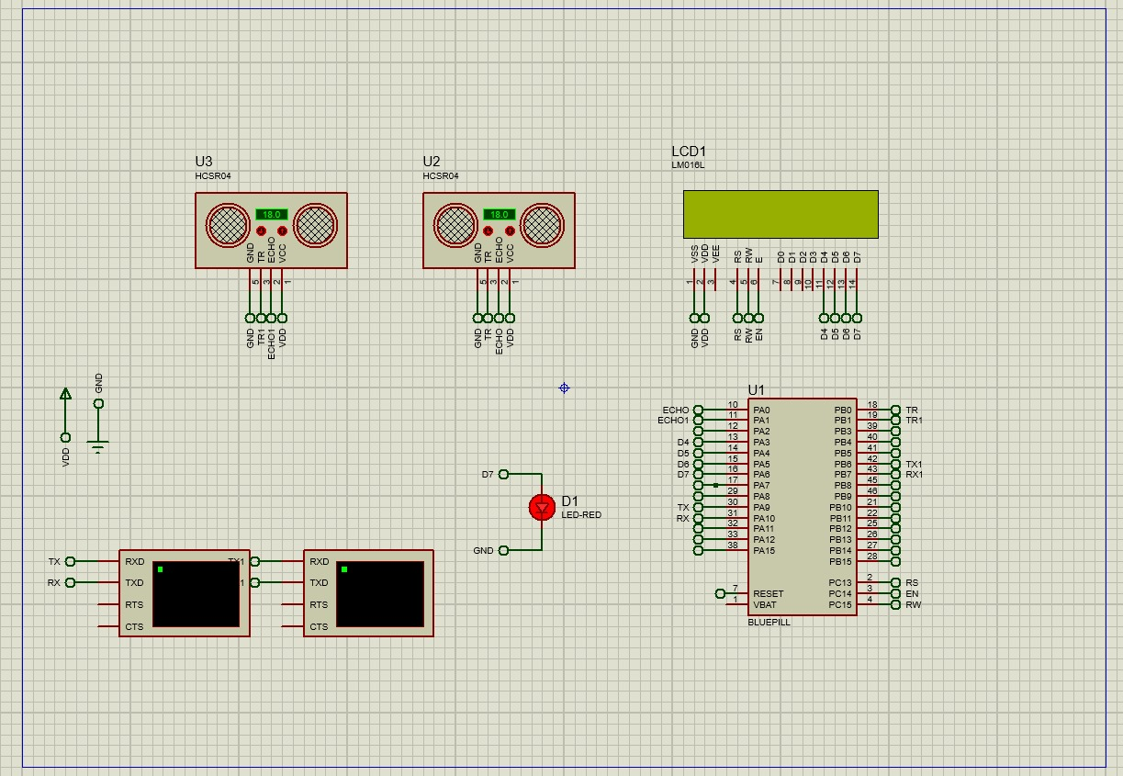
components

Slide 10
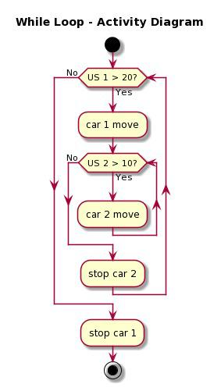
Flow chart

Slide 11
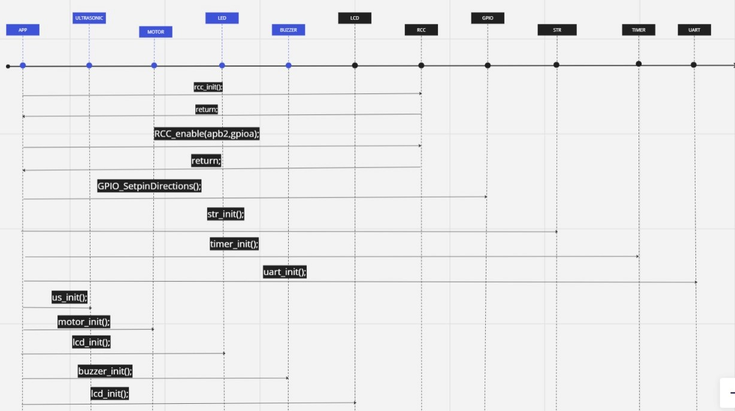
Sequence diagram

Slide 12
Layered architecture

Slide 13
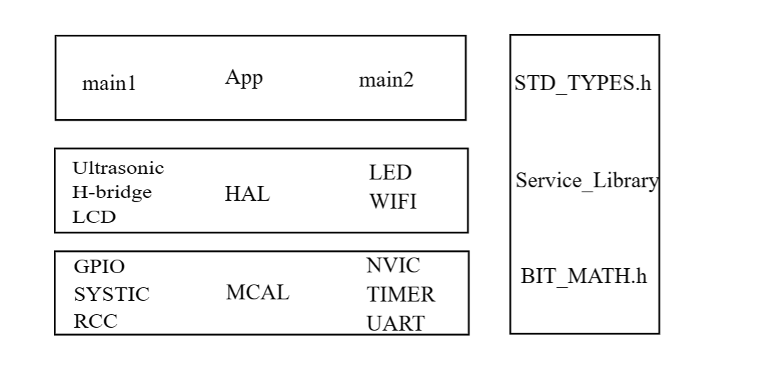
Layered architecture

Slide 14
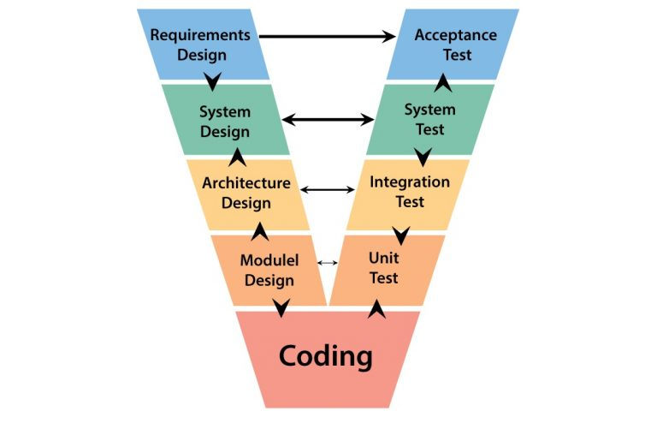
V-Model

Slide 15
WIFI

Slide 16
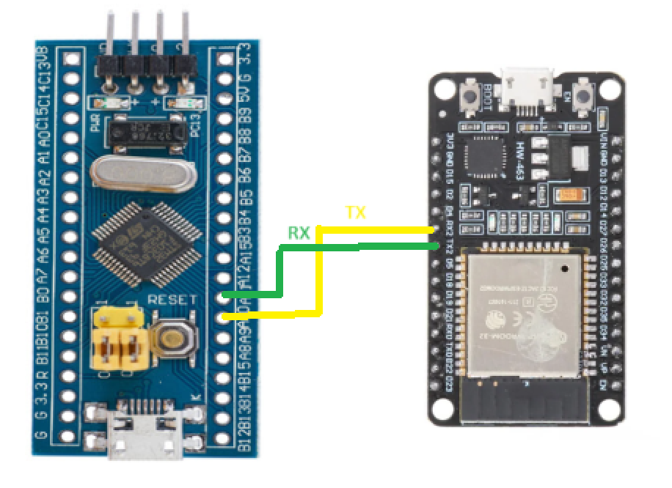
H.W Circuit

Slide 17
ULTRASONIC

Slide 18
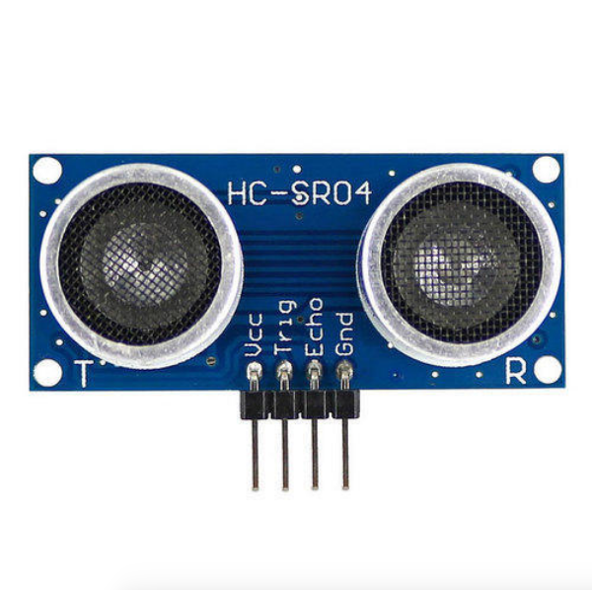
Ultrasonic Sensor
Ultrasonic sensor is an instrument that measures the distance to an object using ultrasonic sound waves. An ultrasonic sensor uses a transducer to send and receive ultrasonic pulses that relay back information about an object's proximity
Features
Supply voltage +5Vdc
Supply Current 10mA
Measurement distance Range from 2cm to 400cm.

Slide 19
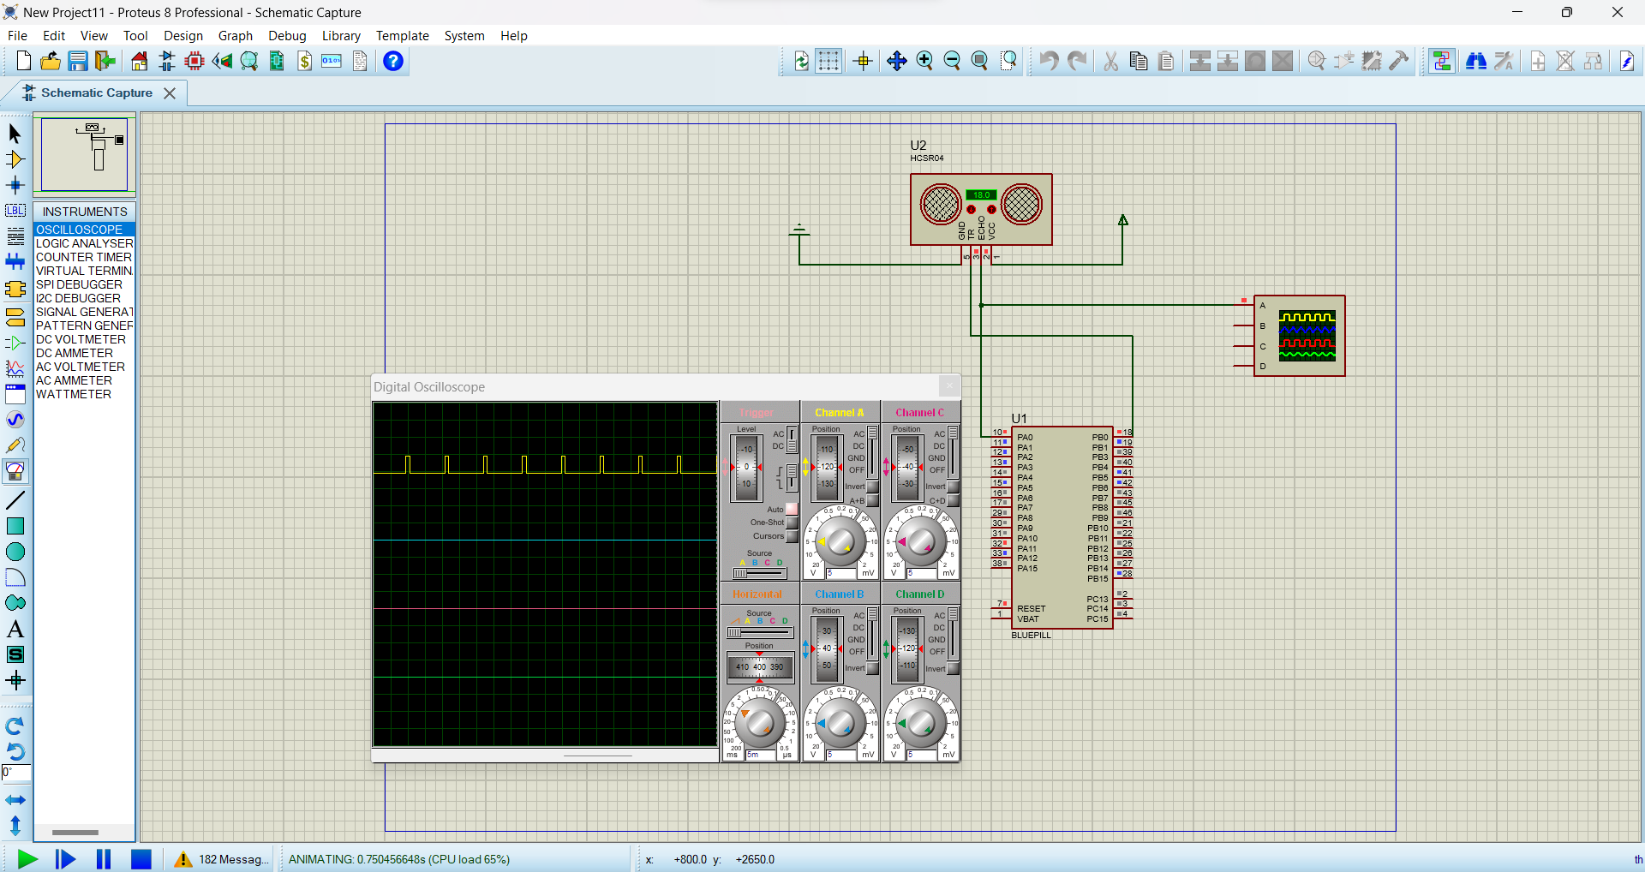
Testing
5

Slide 20
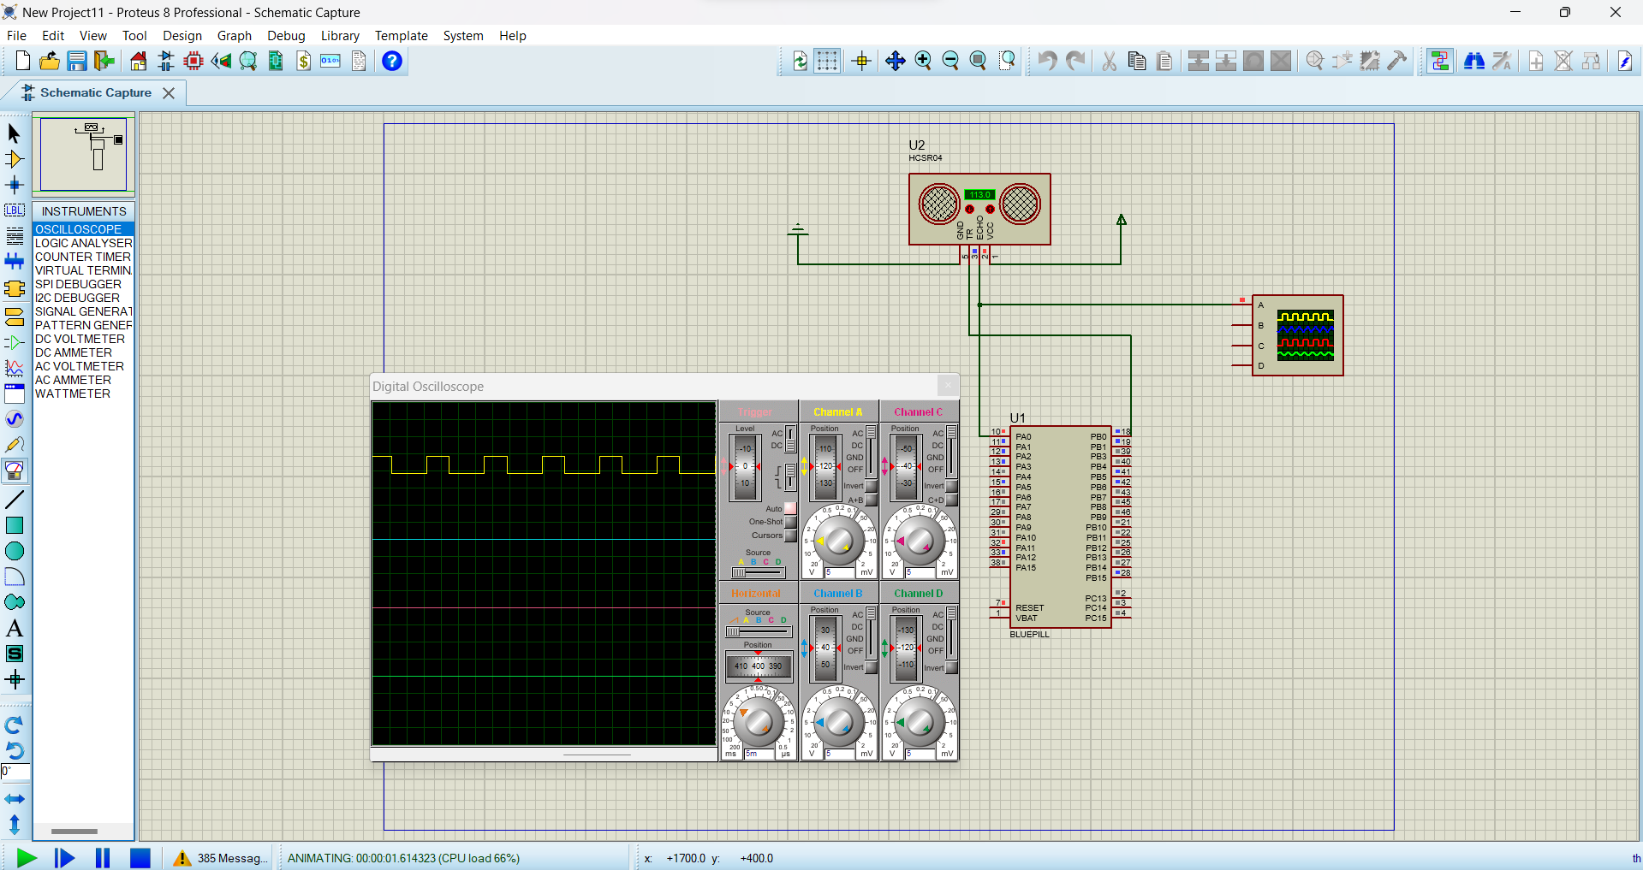
4

Slide 21
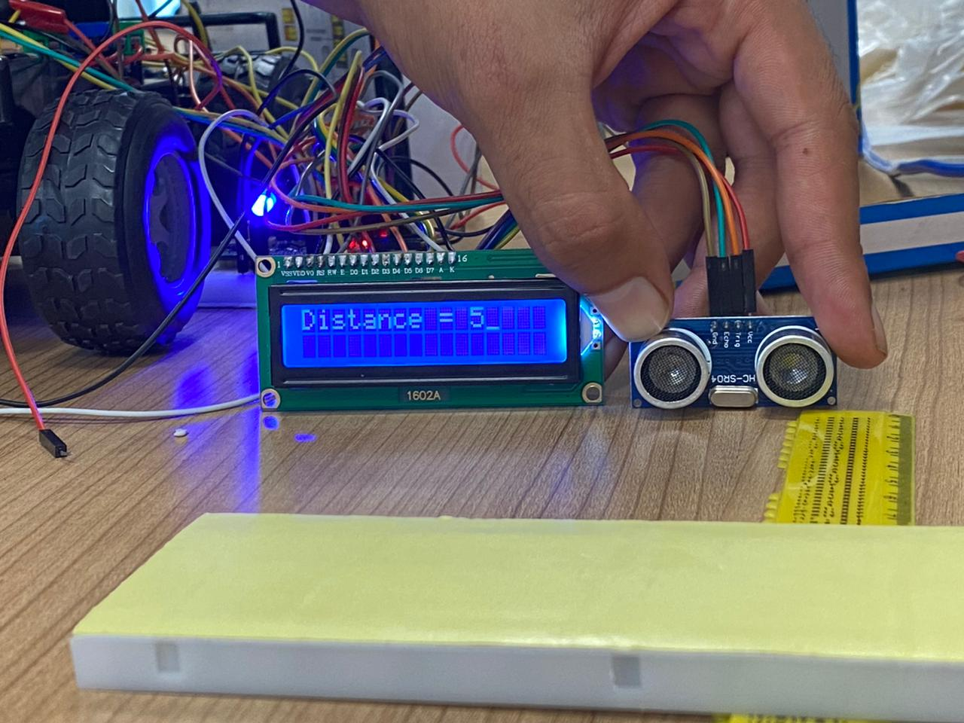
4

Slide 22
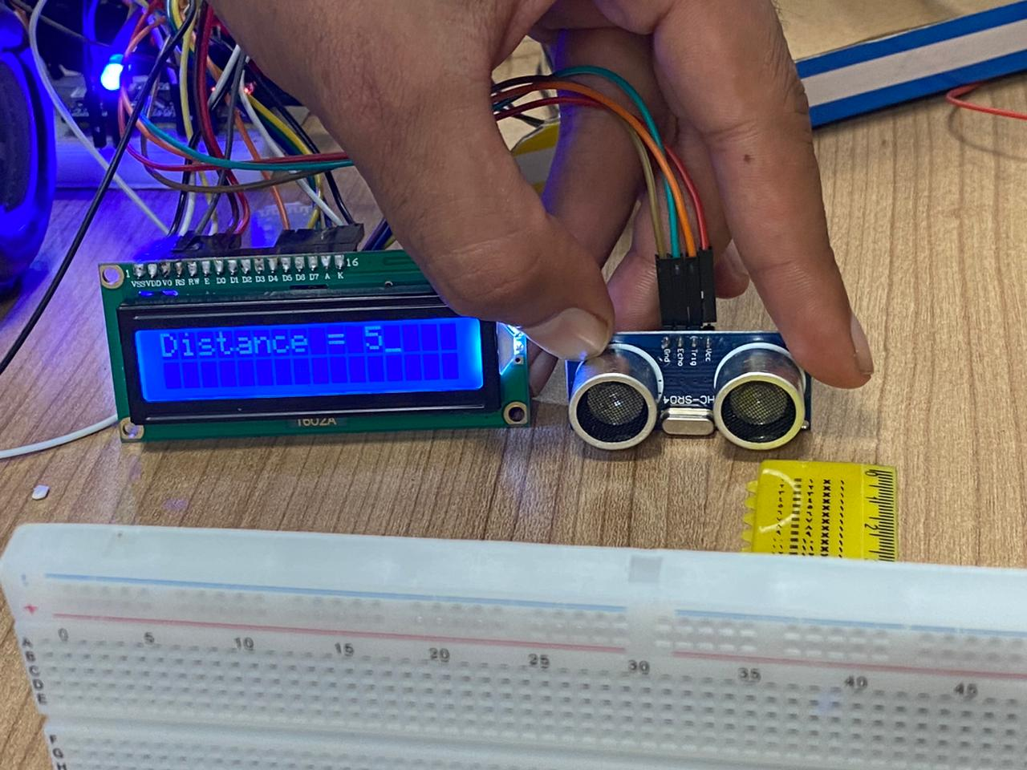
14

Slide 23
HBRIDGE

Slide 24
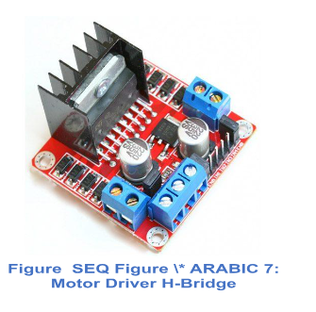
H-Bridge

Slide 25
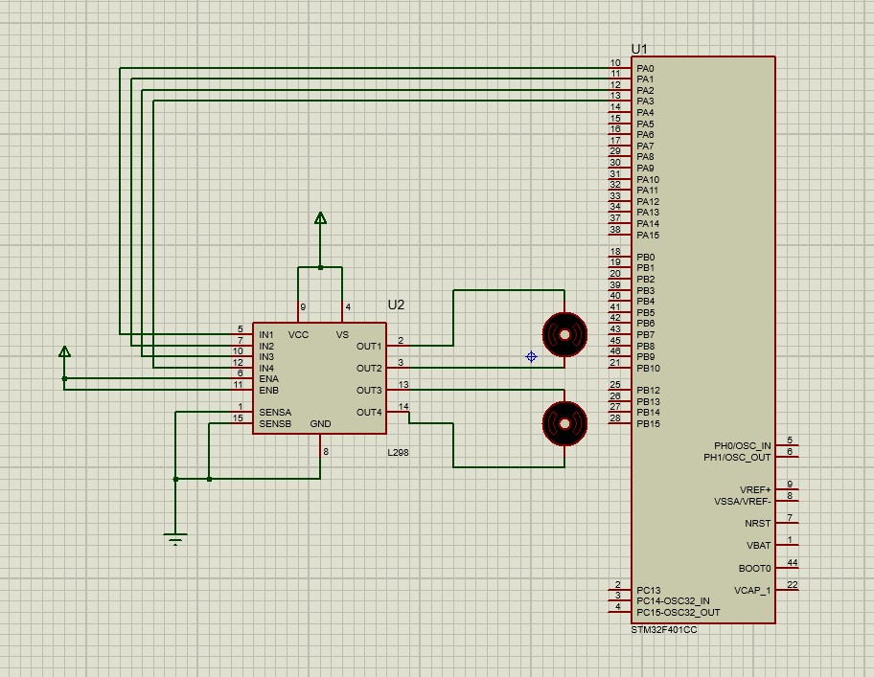
proteus

Slide 26
LCD

Slide 27
FUTURE FEATURES

Slide 28
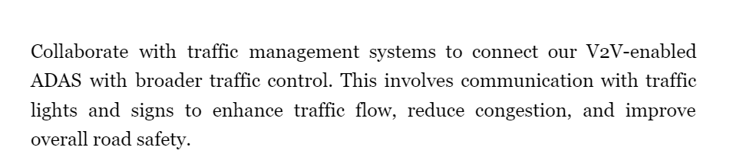
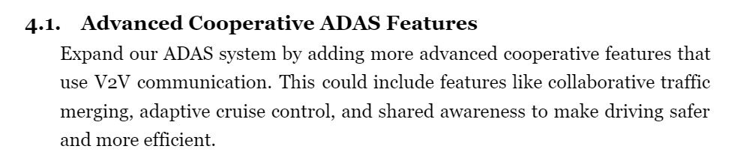
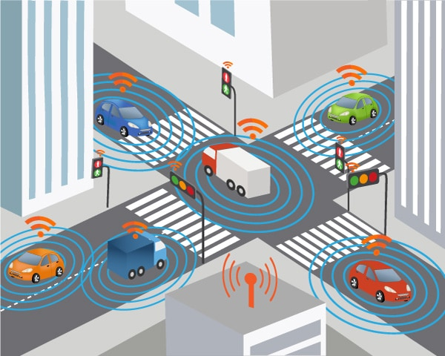
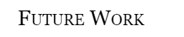

Slide 29
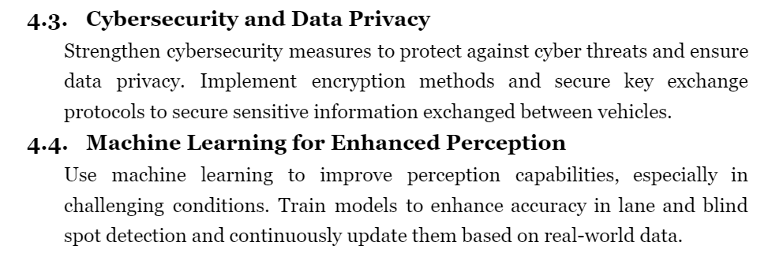
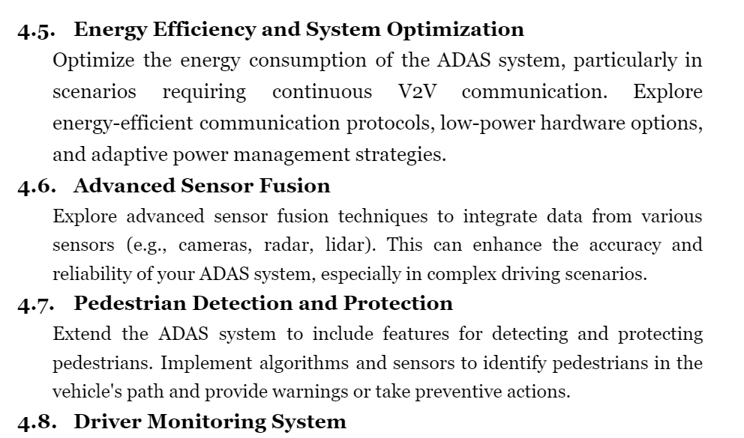
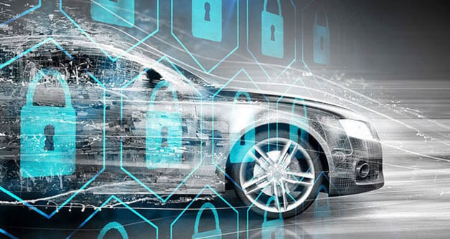

Slide 30
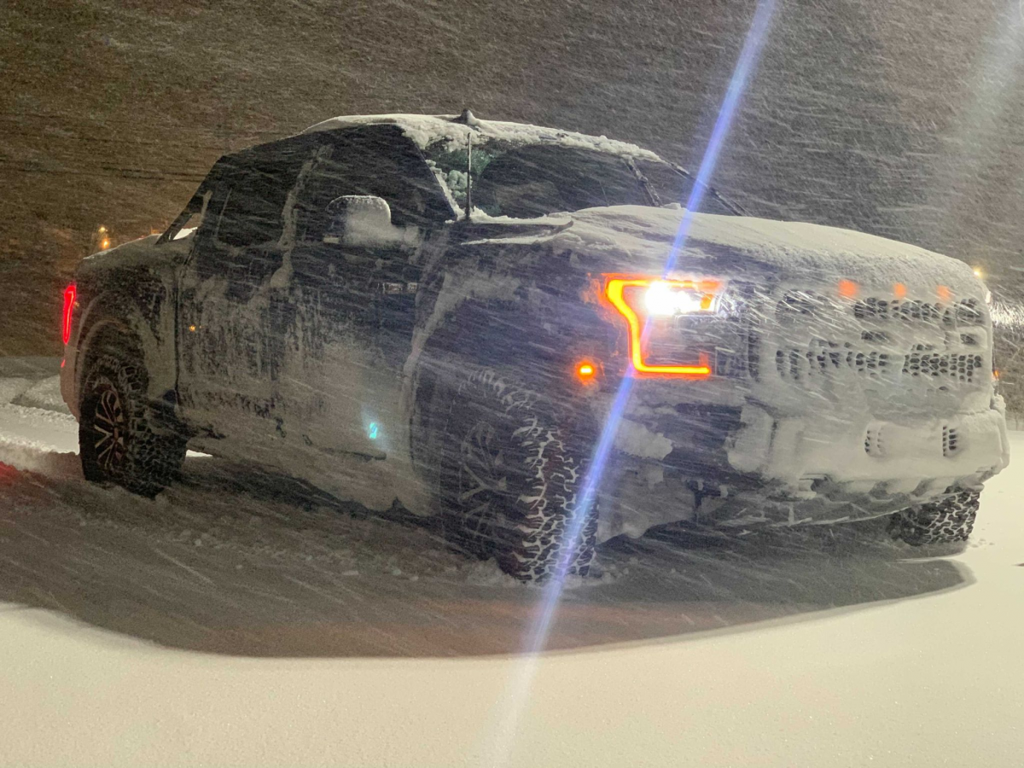
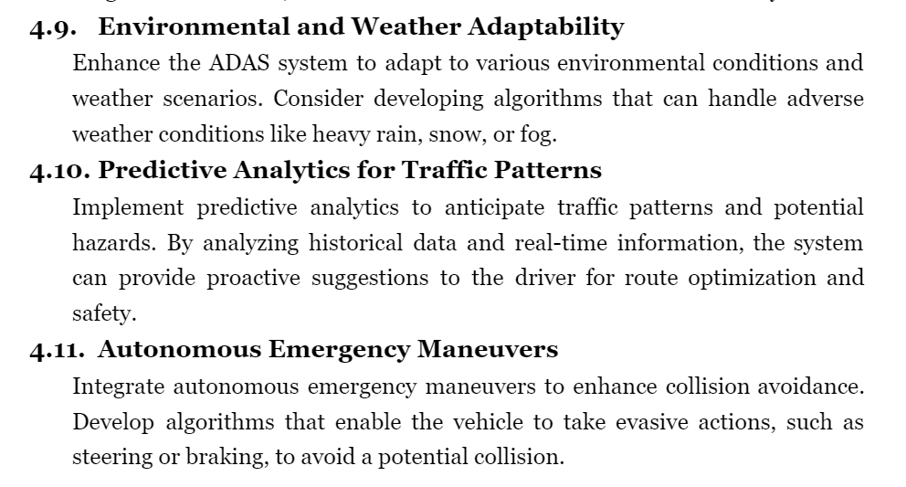
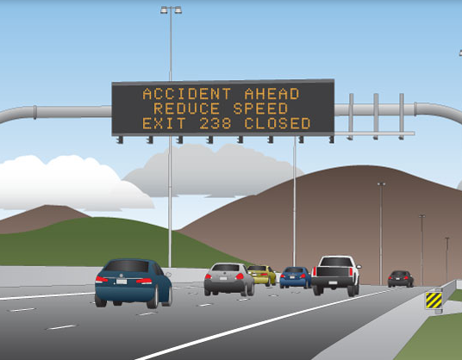

Slide 31
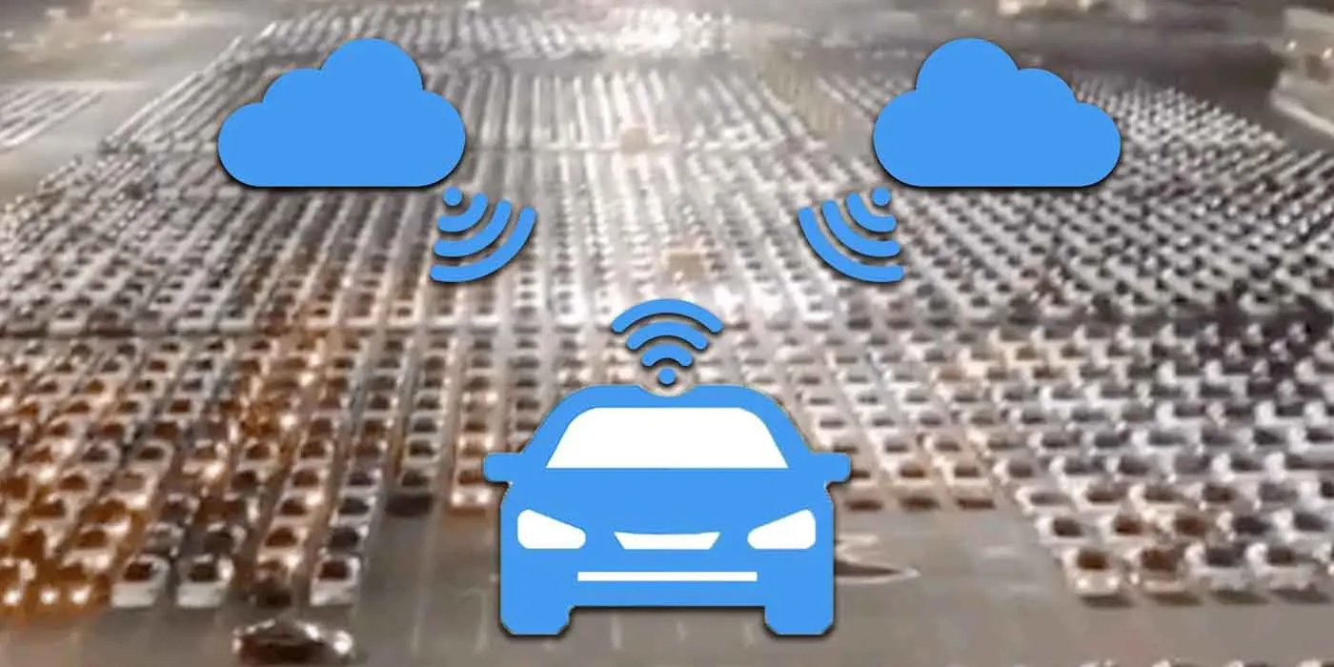
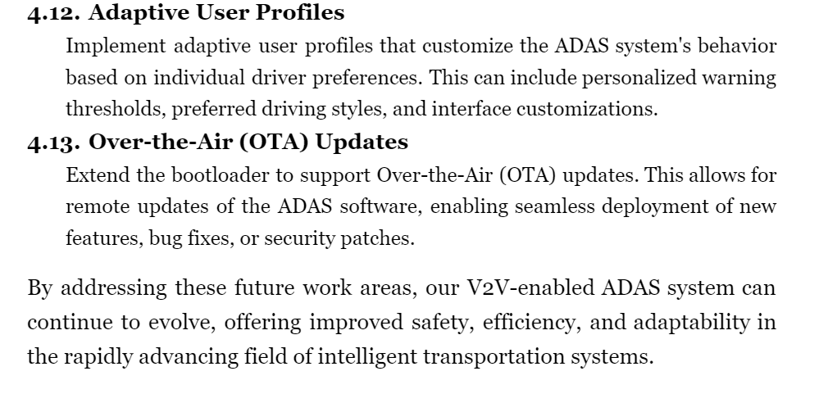

Slide 32
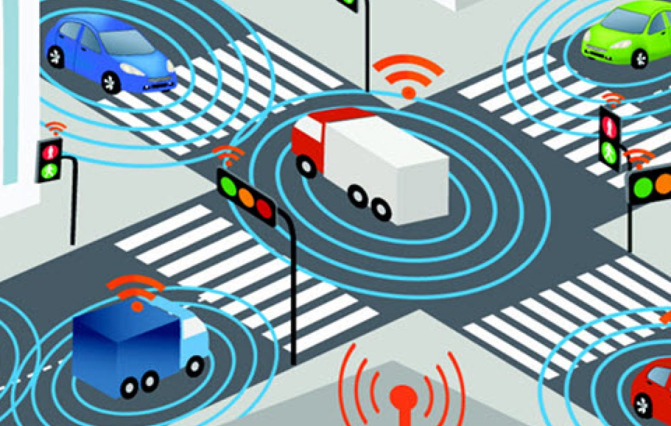
THANK YOU

